Slide 1
Absolute vorticity and planetary Rossby waves
Waves: terms and concepts
harmonic or sinusoidal functions
frequency, period, wavelength, wavenumber, amplitude, phase
phase velocity, group velocity
growing, decaying amplitude (in space or time)
growing, shrinking scale (expressed as wavenumber or wavelength)

Slide 2
Re(exp(i (kx-ωt) )) = Re(exp(ik (x-ct) ))
frequency
period
wavelength
wavenumber
amplitude
phase
phase velocity c=ω/k
group velocity

Slide 3
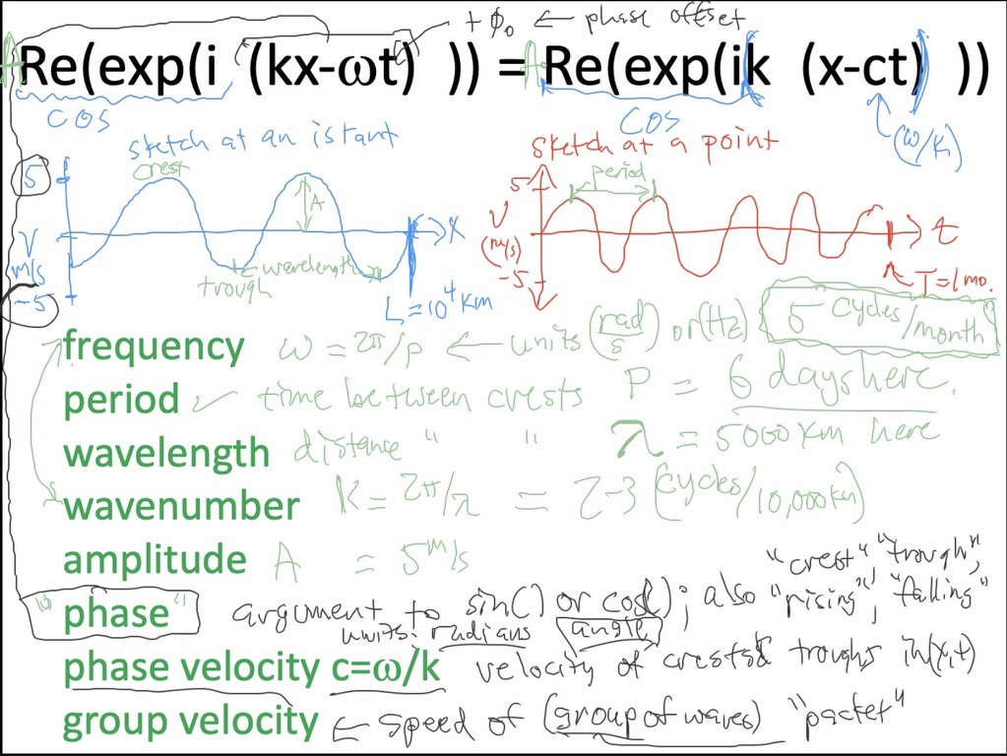

Slide 4
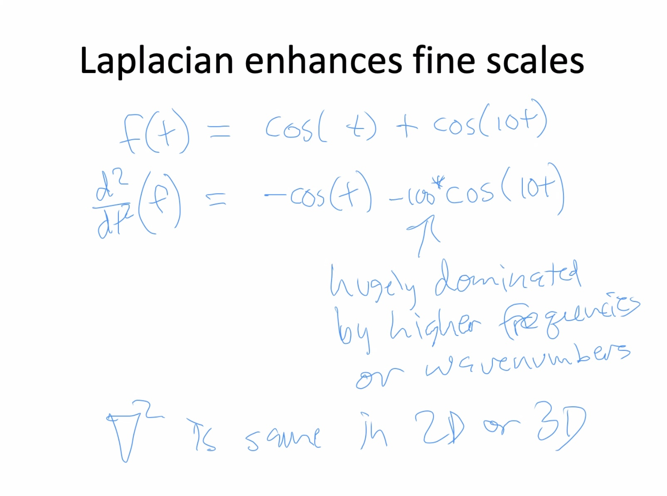
Corollary: inverse of 2nd derivative (Laplacian in 1D,2D,3D,…) is a smoothing operation.

Slide 5
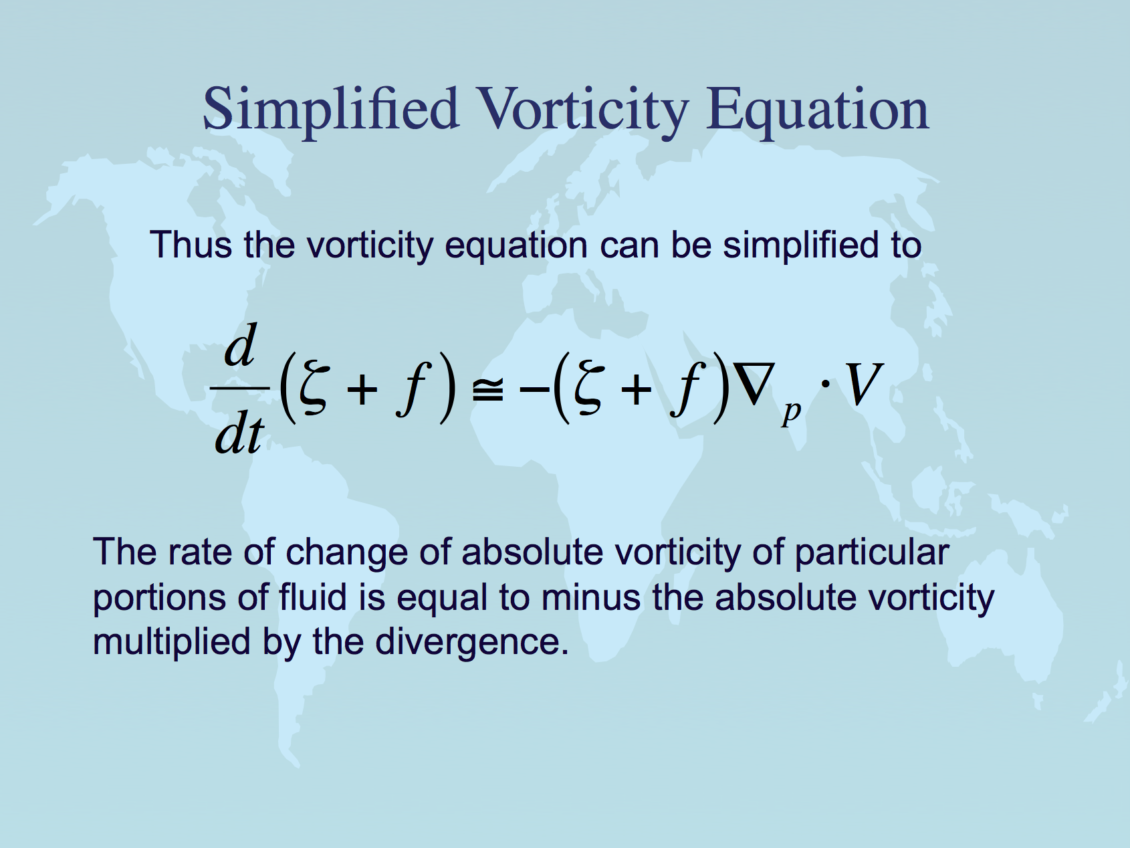
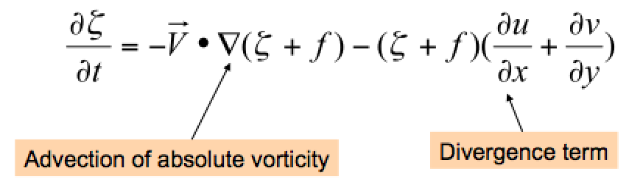
Same equation in Eulerian (local rate of change with time) form.
Lackmann Eq. 1.51

Slide 6
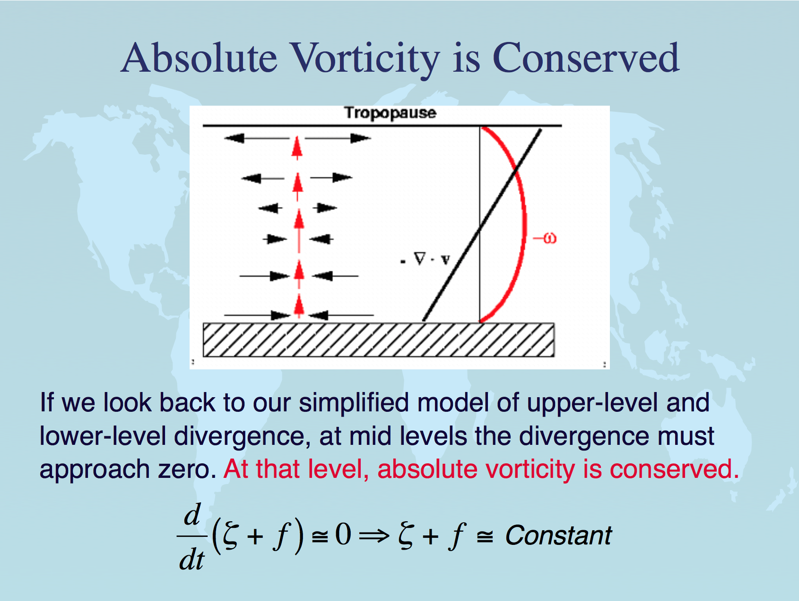
almost,
at midlevels
especially

Slide 7
Conservation of absolute vorticity: how?
When air moves north or south, it tends to conserve its absolute vorticity -- or in other words it converts planetary to relative vorticity. How?
Consider equatorward motion of a disc of fluid.
The initially high f = ζ_{plan} is converted to ζ_{rel}. How?
Physically, the Coriolis force fv is a little bit stronger on its poleward edge (where f is bigger) than on its equatorward edge. This imparts a cyclonic torque on the disk of fluid as it moves southward.
fv
v
All v winds the same, as the disk
moves southward as a unit →
(an eastward PGF must balance the mean Coriolis force, to keep the air flowing southward)
v
fv
v
v
Notes:
\frac {D\zeta_{abs}} {Dt} \simeq 0
\frac {\partial \zeta_{abs}} {\partial t} \simeq -\vec V \cdot \vec \nabla_p \zeta_{abs} - \omega \frac {\partial \zeta_{abs}} {\partial p}

Slide 8
Relative, planetary, and absolute vorticity
absolute = (relative + planetary): ζ_{abs}= ζ_{rel} + ζ_{plan}
planetary vorticity ζ_{plan} = f (aka the “Coriolis parameter”)
f = 2Ω cos(λατιτυδε)
Ω = (2π radians)/(1 day) since the Earth turns once a day
At 40N, f = 10⁻⁴ s⁻¹
Notes:
\frac {D\zeta_{abs}} {Dt} \simeq 0
\frac {\partial \zeta_{abs}} {\partial t} \simeq -\vec V \cdot \vec \nabla_p \zeta_{abs} - \omega \frac {\partial \zeta_{abs}} {\partial p}

Slide 9
Rossby waves: background
Consider a simple westerly flow (constant value of U)
Sinusoidal wave pattern in v is superimposed
Wave assumed to propagate eastward at phase speed c
Wavelength = L
north
Height (streamfunction) contours
Notes:
2

Slide 10
Compute the vorticity for this flow… only v varies, and only in x
Now, take TOTAL time derivative of the ABSOLUTE vorticity….
equal to zero (since it is conserved)
Notes:
2

Slide 11
Note that
Cancel common terms, and we have
Rearrange to solve for c…
Notes:
2

Slide 12
Rossby Wave heuristics and mnemonics
Physically, how can we understand tendency for Rossby waves to propagate westward relative to the flow?
This is related to the “beta-effect”, motion related to the advection of planetary vorticity (the fact that f changes with latitude)
West of trough axis, in northerly flow, larger f advected : trough “built” there
West of ridge axis, in southerly flow, smaller f advected: ridge “built” there
north
Result: whole pattern propagates westward against vorticity advection, which acts to push pattern eastward
Notes:
2

Slide 13
animation
2
1
north
3
f has decreased, ζ increases to compensate: cyclonic turn
Notes:
2

Slide 14
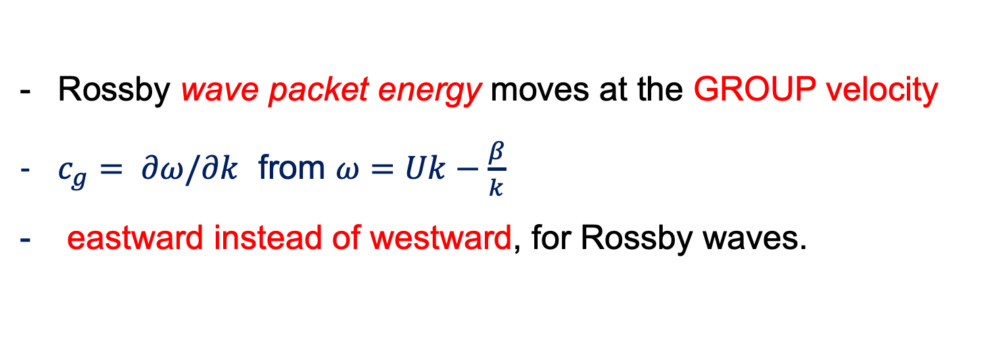
Rossby Waves: phase vs. group velocity
this c is phase velocity
Rossby wave packet energy moves at the GROUP velocity
$c_{g}= ∂ω/∂k$ from $ω=Uk−\frac{β}{k}$
eastward instead of westward, for Rossby waves.
Note!! →
Notes:
2

Slide 15
Rossby wave group velocity energetics (downstream development):
Waves here strengthen
Waves here weaken
Energy flux

Slide 16
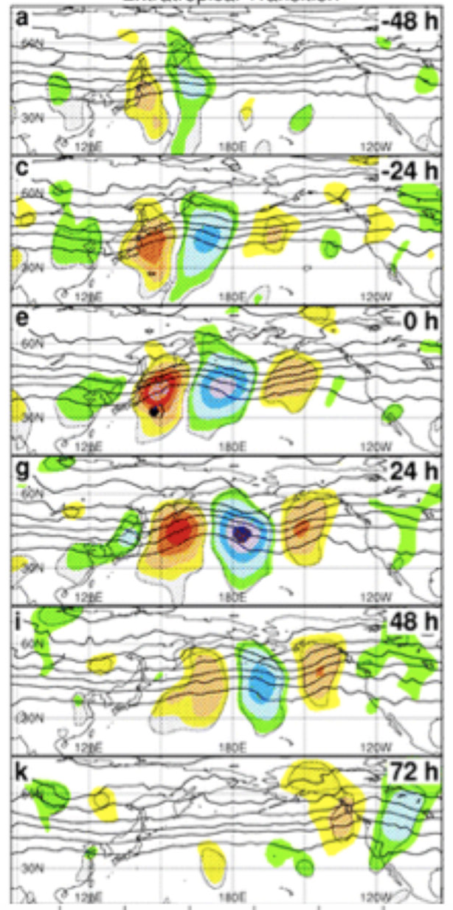
stationary Rossby waves: long waves
advection by U>0 balances westward propagation
important special case because strong forcings are often stationary (like mountains or SST warm pools = convective heat sources)
This is not quite stationary: phase is advected to east→

Slide 17
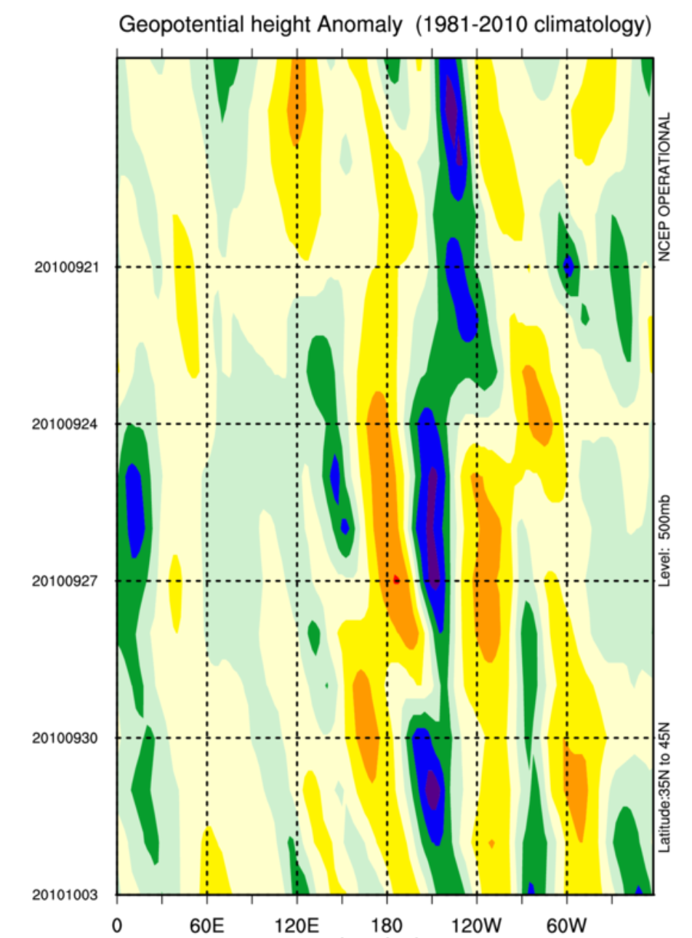
Example:
Z’(lon, time)
diagram
phase velocity near zero (almost stationary waves,) like in the river
time→
group or energy speed: fast eastward

Slide 18
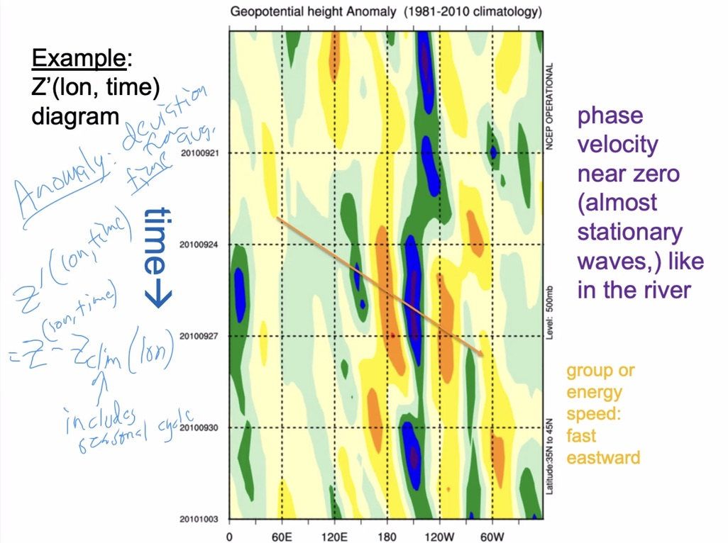

Slide 19
midlatitude Rossby waves review
Wirth, V., M. Riemer, E.K. Chang, and O. Martius, 2018: Rossby Wave Packets on the Midlatitude Waveguide—A Review.
Mon. Wea. Rev., 146, 1965–2001
https://doi.org/10.1175/MWR-D-16-0483.1

Slide 20

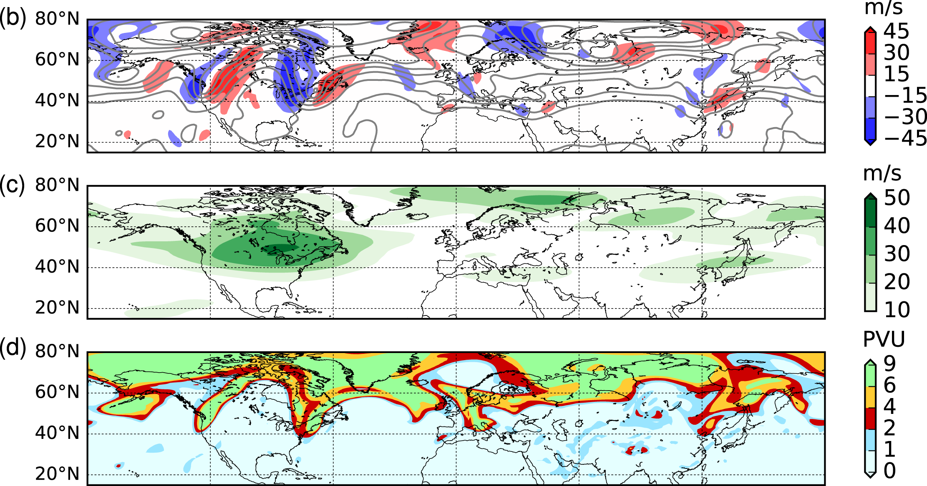
From: Rossby Wave Packets on the Midlatitude Waveguide—A Review
Mon. Wea. Rev.. 2018;146(7):1965-2001. doi:10.1175/MWR-D-16-0483.1
show v
40-60N→
v and Z
u
PV
Figure Legend:
An RWP over North America at 0000 UTC 7 Aug 2002. (a) Magnitude of the horizontal wind at 300 hPa (color shading, in m s⁻¹). (b) Meridional wind υ at 300 hPa (color shading, in m s⁻¹) and isolines of 300-hPa geopotential height Z (black contours, every 150 m). (c) Envelope (color shading, in m s⁻¹) of the meridional wind υ at 300 hPa. (d) Ertel potential vorticity on the 330-K isentrope (color shading, in PVU; 1 PVU = 10⁻⁶ K kg⁻¹ m² s⁻¹). The data used for this figure are from the ERA-Interim project (Dee et al. 2011).
Copyright © 2020 American Meteorological Society

Slide 21
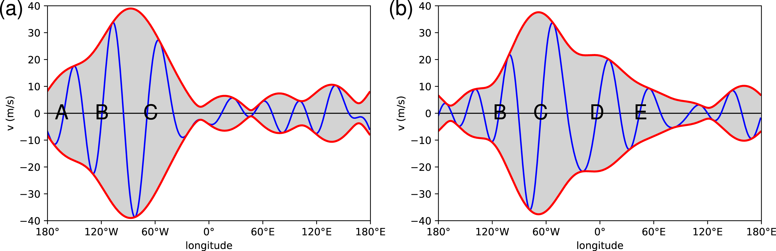
From: Rossby Wave Packets on the Midlatitude Waveguide—A Review
Mon. Wea. Rev.. 2018;146(7):1965-2001. doi:10.1175/MWR-D-16-0483.1
shows v
40-60N
Figure Legend:
Northern Hemisphere RWP at (a) 0000 UTC 7 Aug and (b) 0000 UTC 9 Aug 2002. Both panels show the 300-hPa meridional wind v (blue line, in m s⁻¹) restricted to zonal wavenumbers 4–10 and averaged over 40°–60°N, as well as the corresponding envelope (red lines). The position of individual troughs is diagnosed by the change from negative to positive υ and denoted by capital letters A, B, C,.... The upstream trough A has practically vanished from the RWP during the 48-h time span, while two downstream troughs D and E have been created during that time.
Copyright © 2020 American Meteorological Society

Slide 22
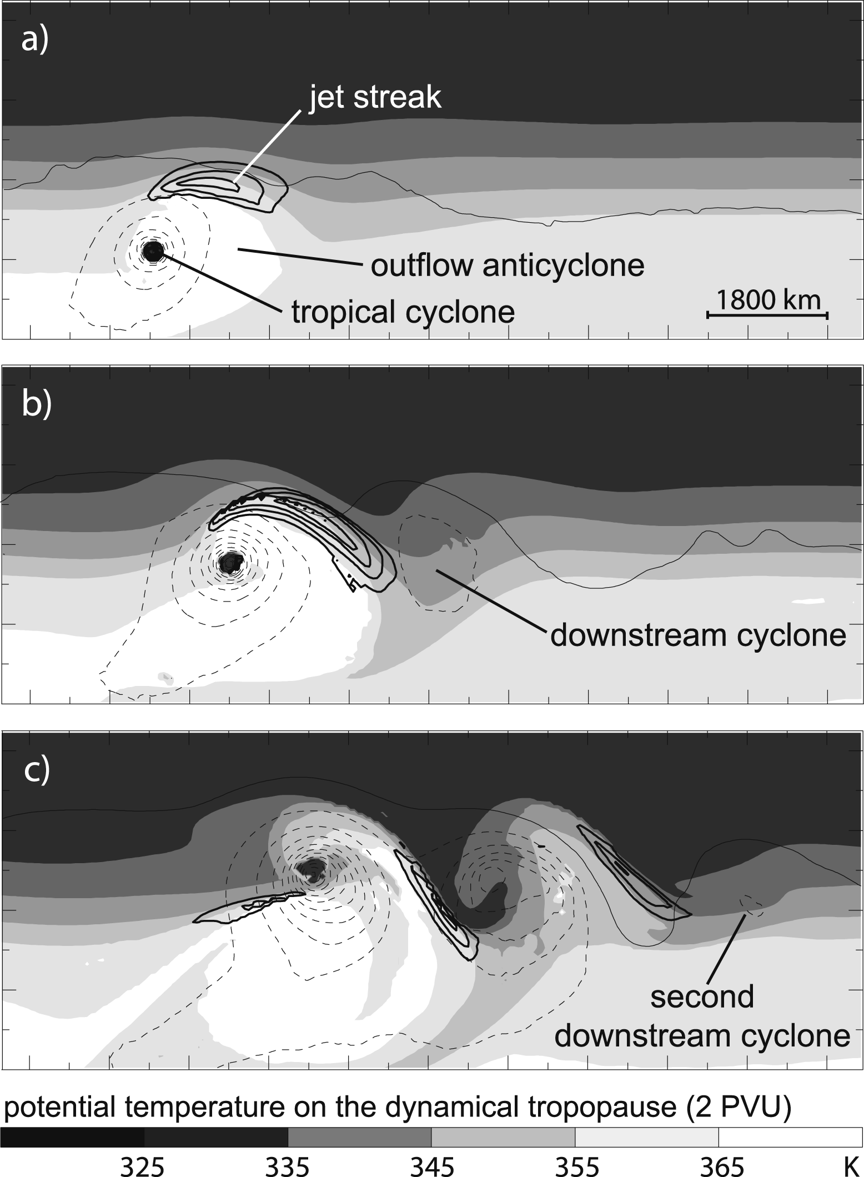
From: Rossby Wave Packets on the Midlatitude Waveguide—A Review
Mon. Wea. Rev.. 2018;146(7):1965-2001.
doi:10.1175/MWR-D-16-0483.1
Figure Legend:
Illustration of the excitation of an RWP by the extratropical transition of a tropical cyclone. (a) 120, (b) 156, and (c) 192 h, respectively, into an idealized numerical experiment with an initially straight jet. The shading denotes potential temperature θ, and the bold solid contours depict wind speed (45 m s⁻¹) on the dynamical tropopause, here defined as the 2-PVU surface. Thin contours show surface pressure, every 5 hPa, dashed for 990 hPa and lower. The horizontal scale is given in (a). [The figure is Figs. 2a–c from Riemer et al. (2008), with modifications.]
Copyright © 2020 American Meteorological Society

Slide 23
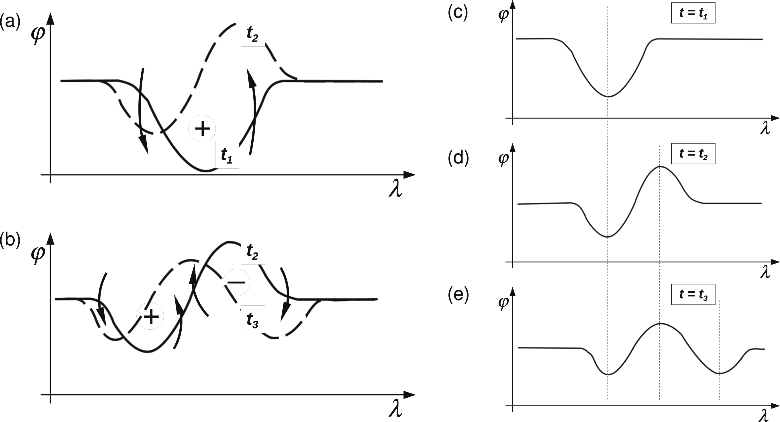
From: Rossby Wave Packets on the Midlatitude Waveguide—A Review
Mon. Wea. Rev.. 2018;146(7):1965-2001. doi:10.1175/MWR-D-16-0483.1
Figure Legend:
Qualitative explanation of barotropic downstream development in the framework of PV thinking. Each panel represents a latitude–longitude map with the lines depicting contours of PV at different times (). The PV gradient of the background atmosphere is northward (i.e., upward in the figure). (left) The circled plus and minus signs represent PV anomalies; the curved arrows represent the wind field associated with these PV anomalies; the solid PV contour depicts an early stage, while the dashed contour represents the situation a short time later (i.e., after the wind had some time to advect the initial contour). (a) The time interval and (b) time interval . (right) The scenario in a frame of reference in which the phase of the troughs and ridges is stationary.
Copyright © 2020 American Meteorological Society

Slide 24
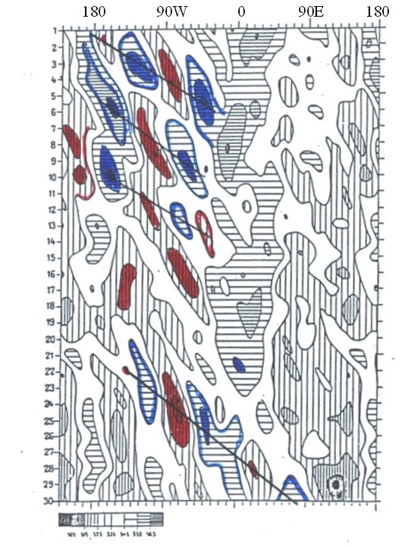
Lackmann
Fig 1.20
wave packet energy moves eastward instead of westward

Slide 25
Open this research paper to its money figure
Open this research paper to its money figure

Slide 26
2. Make time-longitude plots, find a Rossby wave group velocity event
Make a time-longitude plot like LMT Fig. 1.4, exploring a couple fall months and zooming in to some interesting case. The next slide has the code.
Annotate the thing there that looks most like group velocity propagation (downstream development) as in Fig. 1.4.
Find your “source event”. Create a Z’500 map as on the final slide below, fine tuning with the “forward one day” and “backward one day” buttons to see if you can find a clear source (like a WPAC typhoon or North Atlantic hurricane transition).
It may not be very convincing, but please give it the ol college try. It will be fun to compare.

Slide 27
Edit the dates: time-lon book plot
https://psl.noaa.gov/cgi-bin/hovmoller/timeplot.ncl.pl?var=hgt&level=500&mon1=9&mon2=10&day1=18&day2=3&yr1=2010&yr2=2010&datatype=ncepreanalysis&type=anom&fxdlon=no&postscript=no&lon1=&lon2=&lat1=35&lat2=45&cint=&lowr=&highr=&size=100&color=Default&Submit=Create+Plot

Slide 28
Edit the dates: northern hemisphere Z’500 map for a given day
https://psl.noaa.gov/cgi-bin/data/composites/comp.day.pl?var=Geopotential+Height&level=500mb&iy%5B1%5D=2010&im%5B1%5D=09&id%5B1%5D=24&monr1=1&dayr1=1&monr2=1&dayr2=1&iyr%5B1%5D=&filenamein=&plotlabel=&lag=0&labelc=Color&labels=Shaded&type=2&scale=&label=0&skip_vector=&cint=50&lowr=-225&highr=225&istate=0&proj=Northern+Hemisphere&xlat1=&xlat2=&xlon1=&xlon2=&custproj=Cylindrical+Equidistant&level1=1000mb&level2=10mb&Submit=Create+Plot
Use forward and back 1 day buttons there
Capture an image we can share next time about your case

